Slide 1
A variation of tent puzzle
Xiaoliang Jiang

Slide 2
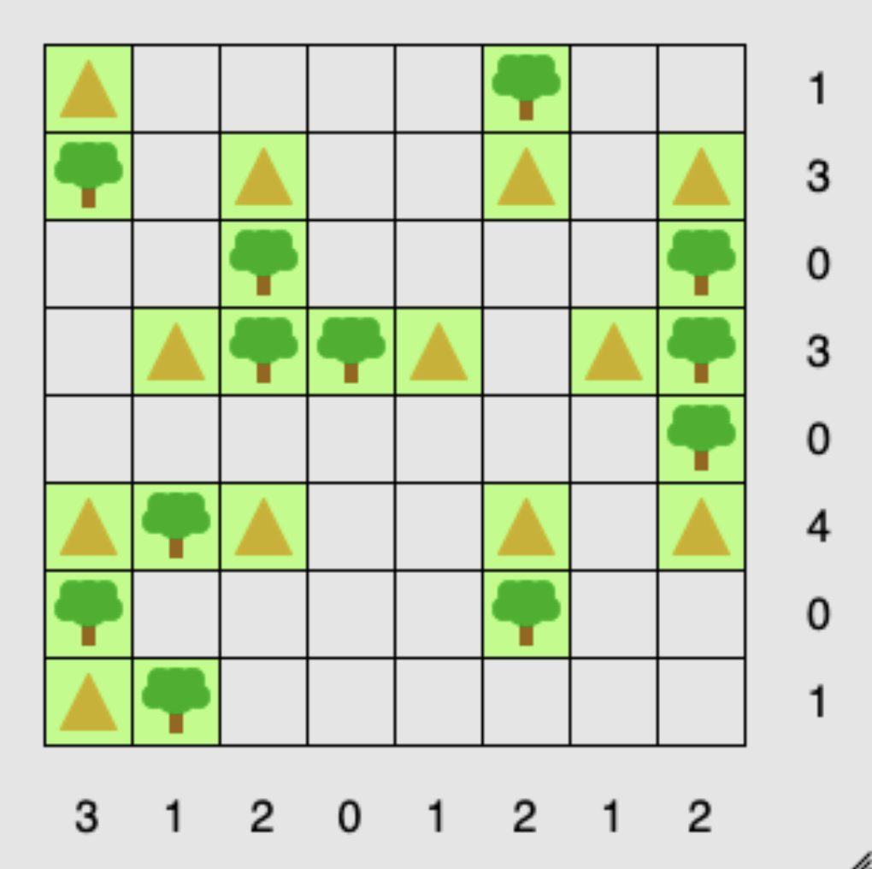
Classic tent puzzle
Place tents in the empty squares.
No two tents are adjacent, even diagonally
The number of tents in each row and column matches the numbers around the edge of the grid

Slide 3
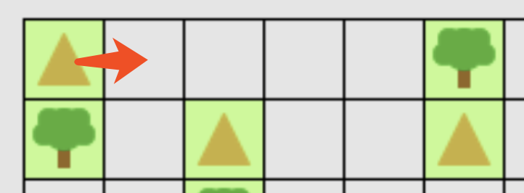
Variation of original puzzle
1. Each tent must have a door to go outside and view the landscape. So, it must open to an empty space and no other tent on its view (in a line).
For example, the tent on the left top can only open the door to the right (assuming boundary is not available for opening a door)

Slide 4
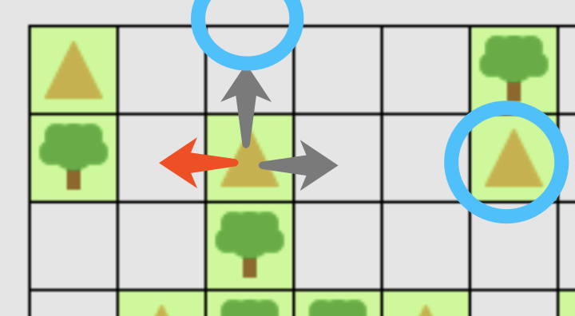
Variation of original puzzle
2. The boundaries are not valid scenes for the owner of tents.
For example, the tent in the left puzzle
can only open the door to the left,
since boundary is on the top and
another tent is on its right.

Slide 5
Variation of original puzzle
Add some ruins on the puzzle. They may be abandoned tents from previous visitor which locate as regular tents but cannot be used any more. New tents cannot build on the ruins and ruins cannot treat as scenes as well.
Therefore, tents’ doors cannot open to the ruins which are like dead tents: they are not calculated in hints number but can block the view.

Slide 6
My approaching
Randomly generate trees on the puzzle board.
Add tent as more as possible based on the original criteria (No two tents are adjacent, even diagonally)
For each tent, trying to find possible directions to open the door. If and only if one direction is available, set the tent to this direction.
Add ruins to make the puzzle valid and calculate the hints number.

Slide 7
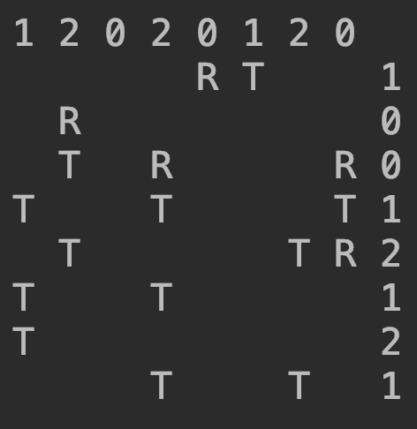
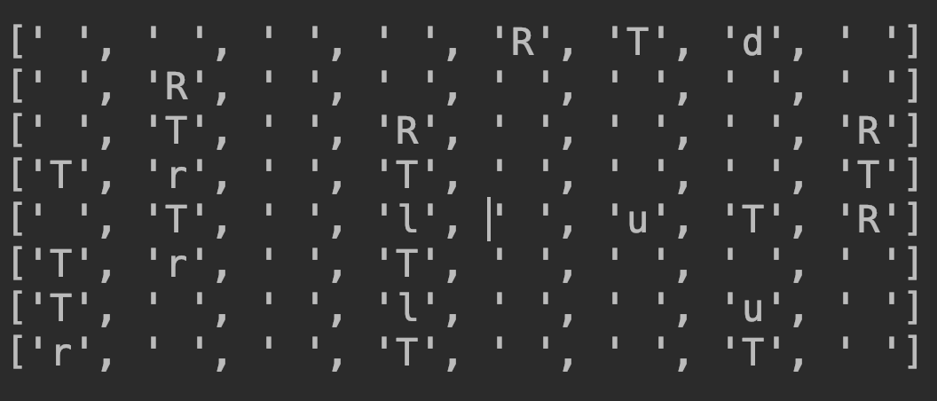
An example of variation puzzle

Slide 8
Thanks

